Slide 1
Tutorial DAGS

Slide 2
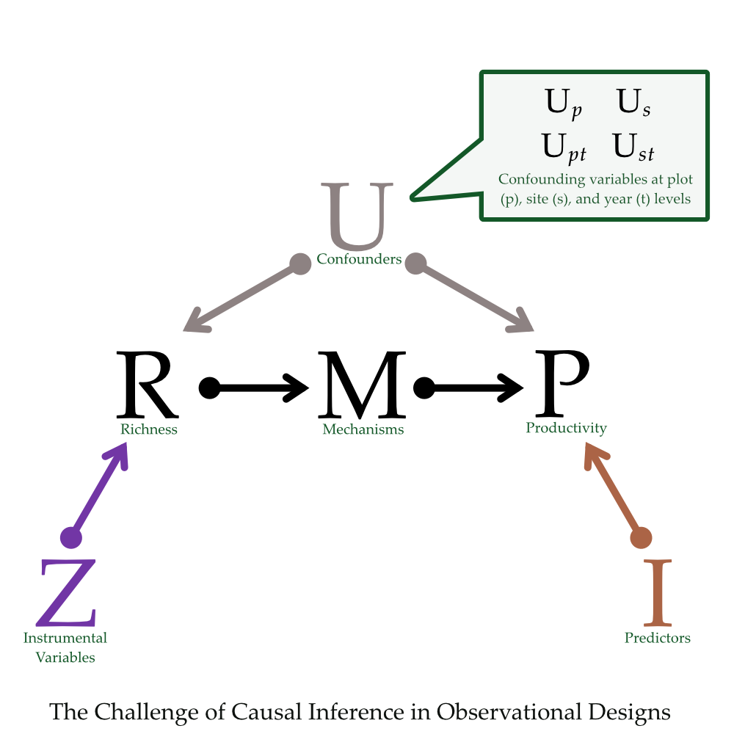
Unobserved

